Slide 1
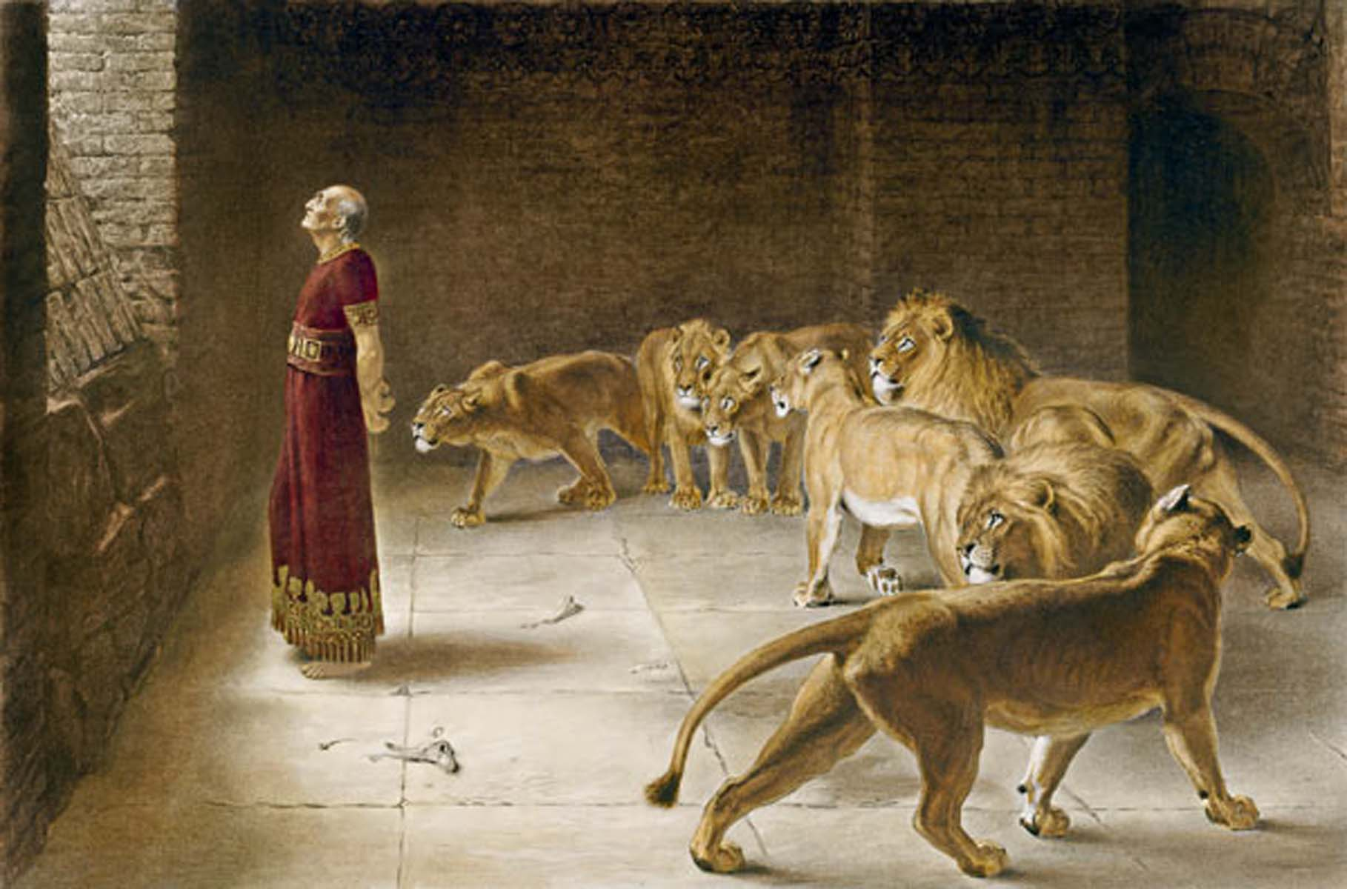
Daniel 但以理書 6:1–28
Prayers from the Life of Daniel
但以理生命中的禱告

Slide 2
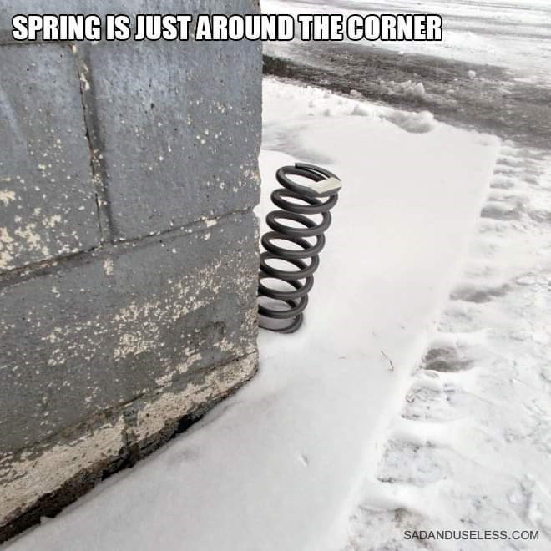
春天就在转角

Slide 3
Daniel 6:1-28
1 It pleased Darius to appoint 120 satraps to rule throughout the kingdom, 2 with three administrators over them, one of whom was Daniel. The satraps were made accountable to them so that the king might not suffer loss. 3 Now Daniel so distinguished himself among the administrators and the satraps by his exceptional qualities that the king planned to set him over the whole kingdom. 4 At this, the administrators and the satraps tried to find grounds for charges against Daniel in his conduct of government affairs, but they were unable to do so. They could find no corruption in him, because he was trustworthy and neither corrupt nor negligent.
但以理書 6:1–28
1大利乌随心所愿，立一百二十个总督，治理通国。
2又在他们以上立总长三人（但以理在其中），使总督在他们三人面前回复事务，免得王受亏损。
3因这但以理有美好的灵性，所以显然超乎其余的总长和总督，王又想立他治理通国。
4那时，总长和总督寻找但以理误国的把柄，为要参他；只是找不着他的错误过失，因他忠心办事，毫无错误过失。

Slide 4
5 Finally these men said, “We will never find any basis for charges against this man Daniel unless it has something to do with the law of his God.” 6 So these administrators and satraps went as a group to the king and said: “May King Darius live forever! 7 The royal administrators, prefects, satraps, advisers and governors have all agreed that the king should issue an edict and enforce the decree that anyone who prays to any god or human being during the next thirty days, except to you, Your Majesty, shall be thrown into the lions’ den. 8 Now, Your Majesty, issue the decree and put it in writing so that it cannot be altered—in accordance with the law of the Medes and Persians, which cannot be repealed.” 9 So King Darius put the decree in writing.
5那些人便说：我们要找参这但以理的把柄，除非在他神的律法中就寻不着。
6于是，总长和总督纷纷聚集来见王，说：愿大利乌王万岁！
7国中的总长、钦差、总督、谋士，和巡抚彼此商议，要立一条坚定的禁令，三十日内，不拘何人，若在王以外，或向神或向人求什么，就必扔在狮子坑中。
8王啊，现在求你立这禁令，加盖玉玺，使禁令决不更改；照玛代和波斯人的例是不可更改的。
9于是大利乌王立这禁令，加盖玉玺。

Slide 5
10 Now when Daniel learned that the decree had been published, he went home to his upstairs room where the windows opened toward Jerusalem. Three times a day he got down on his knees and prayed, giving thanks to his God, just as he had done before. 11 Then these men went as a group and found Daniel praying and asking God for help. 12 So they went to the king and spoke to him about his royal decree: “Did you not publish a decree that during the next thirty days anyone who prays to any god or human being except to you, Your Majesty, would be thrown into the lions’ den?”
The king answered, “The decree stands—in accordance with the law of the Medes and Persians, which cannot be repealed.”
10但以理知道这禁令盖了玉玺，就到自己家里（他楼上的窗户开向耶路撒冷），一日三次，双膝跪在他神面前，祷告感谢，与素常一样。
11那些人就纷纷聚集，见但以理在他神面前祈祷恳求。
12他们便进到王前，提王的禁令，说：王啊，三十日内不拘何人，若在王以外，或向神或向人求什么，必被扔在狮子坑中。王不是在这禁令上盖了玉玺么？王回答说：实有这事，照玛代和波斯人的例是不可更改的。

Slide 6
13 Then they said to the king, “Daniel, who is one of the exiles from Judah, pays no attention to you, Your Majesty, or to the decree you put in writing. He still prays three times a day.” 14 When the king heard this, he was greatly distressed; he was determined to rescue Daniel and made every effort until sundown to save him.
15 Then the men went as a group to King Darius and said to him, “Remember, Your Majesty, that according to the law of the Medes and Persians no decree or edict that the king issues can be changed.”
16 So the king gave the order, and they brought Daniel and threw him into the lions’ den. The king said to Daniel, “May your God, whom you serve continually, rescue you!”
13他们对王说：王啊，那被掳之犹大人中的但以理不理你，也不遵你盖了玉玺的禁令，他竟一日三次祈祷。
14王听见这话，就甚愁烦，一心要救但以理，筹划解救他，直到日落的时候。
15那些人就纷纷聚集来见王，说：王啊，当知道玛代人和波斯人有例，凡王所立的禁令和律例都不可更改。
16王下令，人就把但以理带来，扔在狮子坑中。王对但以理说：你所常事奉的神，他必救你。

Slide 7
17 A stone was brought and placed over the mouth of the den, and the king sealed it with his own signet ring and with the rings of his nobles, so that Daniel’s situation might not be changed. 18 Then the king returned to his palace and spent the night without eating and without any entertainment being brought to him. And he could not sleep.
19 At the first light of dawn, the king got up and hurried to the lions’ den. 20 When he came near the den, he called to Daniel in an anguished voice, “Daniel, servant of the living God, has your God, whom you serve continually, been able to rescue you from the lions?”
17有人搬石头放在坑口，王用自己的玺和大臣的印，封闭那坑，使惩办但以理的事毫无更改。
18王回宫，终夜禁食，无人拿乐器到他面前，并且睡不着觉。
19次日黎明，王就起来，急忙往狮子坑那里去。
20临近坑边，哀声呼叫但以理，对但以理说：永生神的仆人但以理啊，你所常事奉的神能救你脱离狮子么？

Slide 8
21但以理对王说：愿王万岁！
22我的神差遣使者，封住狮子的口，叫狮子不伤我；因我在神面前无辜，我在王面前也没有行过亏损的事。
23王就甚喜乐，吩咐人将但以理从坑里系上来。于是但以理从坑里被系上来，身上毫无伤损，因为信靠他的神。
24王下令，人就把那些控告但以理的人，连他们的妻子儿女都带来，扔在狮子坑中。他们还没有到坑底，狮子就抓住他们，咬碎他们的骨头。
21 Daniel answered, “May the king live forever! 22 My God sent his angel, and he shut the mouths of the lions. They have not hurt me, because I was found innocent in his sight. Nor have I ever done any wrong before you, Your Majesty.”
23 The king was overjoyed and gave orders to lift Daniel out of the den. And when Daniel was lifted from the den, no wound was found on him, because he had trusted in his God.
24 At the king’s command, the men who had falsely accused Daniel were brought in and thrown into the lions’ den, along with their wives and children. And before they reached the floor of the den, the lions overpowered them and crushed all their bones.

Slide 9
25那时，大利乌王传旨，晓谕住在全地各方、各国、各族的人说：愿你们大享平安！
26现在我降旨晓谕我所统辖的全国人民，要在但以理的神面前，战兢恐惧。因为他是永远长存的活神，他的国永不败坏；他的权柄永存无极！
27他护庇人，搭救人，在天上地下施行神迹奇事，救了但以理脱离狮子的口。
28如此，这但以理，当大利乌王在位的时候和波斯王古列在位的时候，大享亨通。
25 Then King Darius wrote to all the nations and peoples of every language in all the earth: “May you prosper greatly! 26 “I issue a decree that in every part of my kingdom people must fear and reverence the God of Daniel.
“For he is the living God and he endures forever; his kingdom will not be destroyed, his dominion will never end. 27 He rescues and he saves; he performs signs and wonders in the heavens and on the earth. He has rescued Daniel from the power of the lions.”
28 So Daniel prospered during the reign of Darius and the reign of Cyrus the Persian.

Slide 10
1st Prayer
GOD MAKE ME A MAN / WOMAN OF UNCORRUPT CHARACTER
Daniel 6:4 At this, the administrators and the satraps tried to find grounds for charges against Daniel in his conduct of government affairs, but they were unable to do so. They could find no corruption in him, because he was trustworthy and neither corrupt nor negligent.
第一個禱告
神啊，使我成為一個品格正直、不受玷污的人
但以理書 6:4
那时，总长和总督寻找但以理误国的把柄，为要参他；只是找不着他的错误过失，因他忠心办事，毫无错误过失。

Slide 11
ARE YOU A MAN / WOMAN OF UNCORRUPT CHARACTER?
HOW DO I BECOME A MAN / WOMAN OF UNCORRUPT CHARACTER?
I LOVE GOD ABOVE ALL OTHER LOVES.
你是品格正直、不受玷污的人嗎?
我要如何成為一個品格正直、不受玷污的人？
我愛神，勝過一切所愛

Slide 12
2nd Prayer
GOD MAKE ME A MAN / WOMAN WHO CONSISTANTLY SEEKS (PRAYS) AND SERVES YOU.
Daniel 6:10 Now when Daniel learned that the decree (only pray to King Darius) had been published, he went home to his upstairs room where the windows opened toward Jerusalem. Three times a day he got down on his knees and prayed, giving thanks to his God, just as he had done before.
第二個禱告
神啊，使我成為一個常常尋求（禱告）並事奉祢的人。
但以理書 6:10
但以理知道这禁令盖了玉玺，就到自己家里（他楼上的窗户开向耶路撒冷），一日三次，双膝跪在他神面前，祷告感谢，与素常一样。

Slide 13
ARE YOU A MAN / WOMAN WHO CONSISTANTLY SEEKS AND SERVES GOD?
HOW DO I BECOME A MAN / WOMAN WHO CONSISTENTLY SEEKS AND SERVES GOD?
I MAKE GOD MY PRIORITY
你是常常尋求, 禱告, 並事奉神的人嗎？
我要如何成為一個常常尋求, 禱告, 並事奉神的人？
我以神為我生命的首位

Slide 14
3rd Prayer
GOD SHUT THE MOUTHS OF MY LIONS
Daniel 6:19-22 19 At the first light of dawn, the king got up and hurried to the lions’ den. 20 …“Daniel, servant of the living God, has your God, whom you serve continually, been able to rescue you from the lions?” 21 Daniel answered, “May the king live forever! 22 My God sent his angel, and he shut the mouths of the lions. They have not hurt me, because I was found innocent in his sight. Nor have I ever done any wrong before you, Your Majesty.”
第三個禱告
神啊，求你堵住我生命中獅子的口
但以理書6:19-22
19次日黎明，王就起来，急忙往狮子坑那里去。
20临近坑边，哀声呼叫但以理，对但以理说：永生神的仆人但以理啊，你所常事奉的神能救你脱离狮子么？
21但以理对王说：愿王万岁！
22我的神差遣使者，封住狮子的口，叫狮子不伤我；因我在神面前无辜，我在王面前也没有行过亏损的事。

Slide 15
4th Prayer
GOD, LIFT ME OUT OF MY LION’S DEN
5th Prayer
GOD, MAKE ME A MAN / WOMAN WHO TRUSTS YOU.
Daniel 6:23 The king was overjoyed and gave orders to lift Daniel out of the den. And when Daniel was lifted from the den, no wound was found on him, because he had trusted in his God.
第四個禱告
神啊，求你把我從獅子坑中拯救出來
第五個禱告
神啊，使我成為一個全然信靠你的人
但以理書6:23
王就甚喜乐，吩咐人将但以理从坑里系上来。于是但以理从坑里被系上来，身上毫无伤损，因为信靠他的神。

Slide 16
LET’S PRAY
讓我們一起禱告

